Slide 1
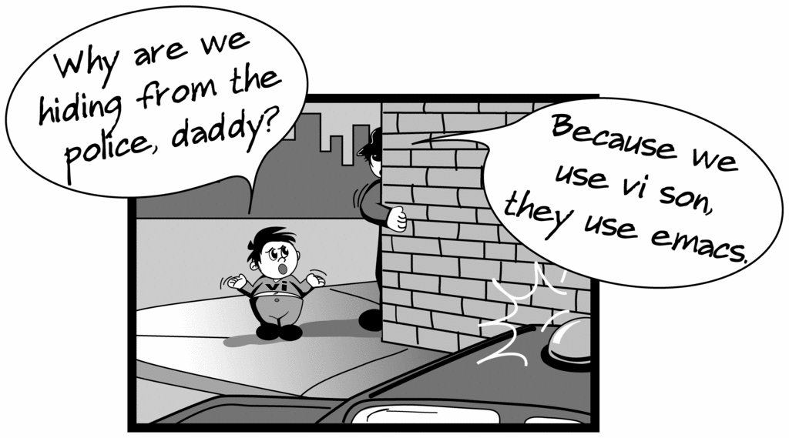
Creating files in Unix/Linux
Requires the use of an Editor
Various Editors:
nano / pico
vi
emacs

Slide 2
Vi editor
The VI editor is the most popular and classic text editor in the Linux family.
Below, are some reasons which make it a widely used editor –
1) available in almost all Linux Distributions
2) works the same across different platforms and Distributions
3) user-friendly.

Slide 3
Modes of Vi editor
Command Mode
Insert Mode
Escape Mode

Slide 4
Modes of Vi editor
Command Mode - vi starts in Command Mode.
vi interprets any characters we type as commands and does not display them in the window.
This mode allows us to move through a file, and to delete, copy, or paste a piece of text. To enter into Command Mode from any other mode, it requires pressing the [Esc] key. If we press [Esc] when we are already in Command Mode, then vi will beep or flash the screen.

Slide 5
Insert Mode - enables you to insert text into the file. –
-Everything that’s typed in this mode is interpreted as input and finally, it is put in the file.
-The vi always starts in command mode. To enter text, you must be in insert mode. To come in insert mode you simply type i. To get out of insert mode, press the Esc key, which will put you back into command mode.

Slide 6
Escape Mode
- enables you to perform tasks such as saving files, executing commands.
-invoked by typing a colon [:], while vi is in Command Mode.
-The cursor will jump to the last line of the screen and vi will wait for a command.

Slide 7
vi editing commands
i - Insert at cursor (goes into insert mode)
a - Write after cursor (goes into insert mode)
A - Write at the end of line (goes into insert mode)
ESC - Terminate insert mode
U - Undo all changes to the entire line
o - Open a new line (goes into insert mode)
dd - Delete line
3dd - Delete 3 lines.

Slide 8
D - Delete contents of line after the cursor
dw - Delete word
4dw - Delete 4 words
cw - Change word
x - Delete character at the cursor
r - Replace character
R - Overwrite characters from cursor onward

Slide 9
s - Substitute one character under cursor continue to insert
S - Substitute entire line and begin to insert at the beginning of the line
Make sure you press the right command otherwise you will end up making undesirable changes to the file.
You can also enter the insert mode by pressing a, A, o,

Slide 10
Moving within file
k - Move cursor up
j - Move cursor down
h - Move cursor left
l - Move cursor right

Slide 11
Saving and closing file
:w - Save the file but keep it open
:q - Quit without saving
:wq - Save the file and quit

Slide 12
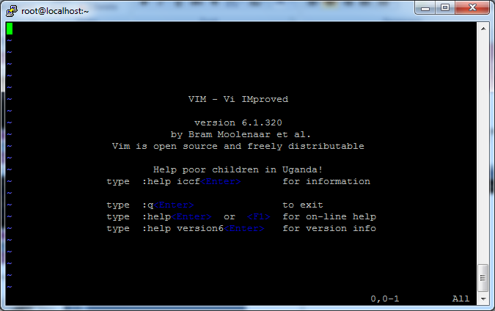
Editing a file using vi
Type “vi” at the prompt

Slide 13
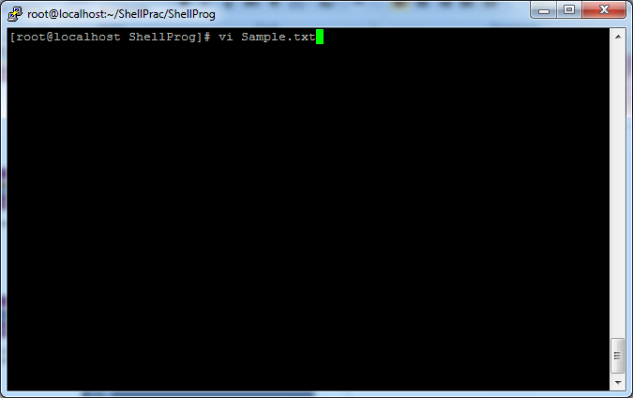
Create a file using vi
Type vi Sample.txt

Slide 14
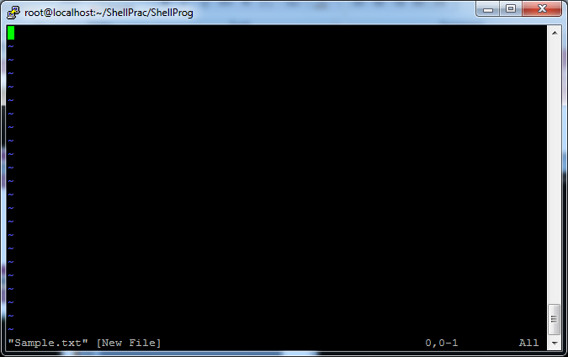
Create a file using vi
After Typing vi Sample.txt, File Created

Slide 15
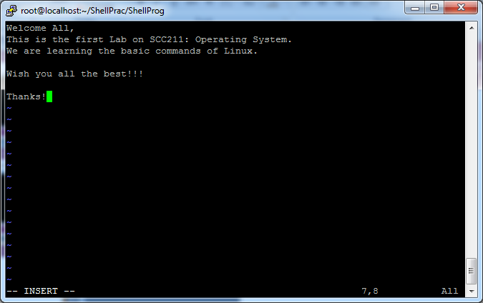
Insert text in a file using vi
To insert: Esc+ i

Slide 16
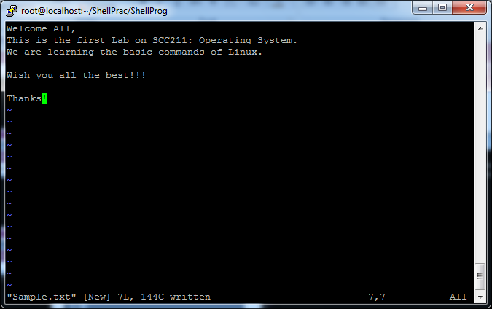
Insert text in a file using vi
To Save File: Esc+ : + w

Slide 17
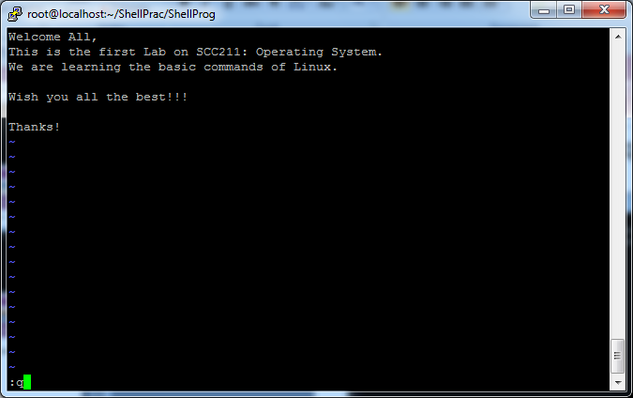
Insert text in a file using vi
To Quit File: Esc+ : + q

Slide 18
Displaying a file
Various ways to display a file in Unix
cat
less
head
tail

Slide 19
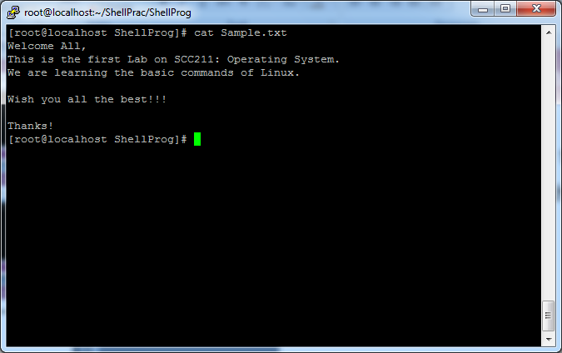
Command: cat
Dumps an entire file to standard output
Good for displaying short, simple files

Slide 20
chmod
There are three types of permissions: read (r), write (w), and execute (x).
To read a file is to view its contents. For example, a text file must have read permission for someone to read the text within.
If the user wants to add a sentence to that file, it needs write permission.
The execute permission enables someone to run a file, such as a shell script or a binary program file
The ls -l command displays the permissions assigned to a file.

Slide 21

user, group, and other.
Each file is associated with an owner and a group and assigned with permission access rights for three different classes of users:
The file owner.
The group members.
Others (everybody else)

Slide 22
operation
- Removes the specified permissions.
+ Adds specified permissions.
= Changes the current permissions to the specified permissions. If no permissions are specified after the = symbol, all permissions from the specified user class are removed.

Slide 23
Directories are special types of files that contain other files and directories.
Permission | Character | Meaning on Directory
Read | - | The directory’s contents cannot be shown.
 | r | The directory’s contents can be shown. (e.g. You can list files inside the directory with ls.)
Write | - | The directory’s contents cannot be altered.
 | w | The directory’s contents can be altered. (e.g. You can create new file ,delete file..etc.)
Execute | - | The directory cannot be changed to.
 | x | The directory can be navigated using cd.

Slide 24
The chmod command allows you to change the permissions on a file using either a symbolic or numeric mode or a reference file.
Symbolic (Text) Method
chmod [OPTIONS] [ugoa…][-+=]perm s FILE
The permissions (perms...) can be explicitly set using either zero or one or more of the following letters: r, w, x . Use a single letter from the set u, g, and o when copying permissions from one to another users class.

Slide 25
Numeric Method
The syntax of the chmod command when using numeric method has the following format
chmod [OPTIONS] NUMBER FILE...
When using the numeric mode, you can set the permissions for all three user classes (owner, group, and all others) at the same time.
the first digit represents the permissions of the file’s owner, the second one the file’s group, and the last one all other users.

Slide 26
Each write, read, and execute permissions have the following number value:
r (read) = 4
w (write) = 2
x (execute) = 1
no permissions = 0
The permissions number of a specific user class is represented by the sum of the values of the permissions for that group.

Slide 27
calculate the totals for all users classes. For example, to give read, write and execute permission to the file’s owner, read and execute permissions to the file’s group and only read permissions to all other users you would do the following:
Owner: rwx=4+2+1=7
Group: r-x=4+0+1=5
Others: r-x=4+0+0=4
Using the method above we come up to the number 754, which represents the desired permissions.

Slide 28
ping
The ping command lets you verify that you have network connectivity with another network device. It is commonly used to help troubleshoot networking issues. To use ping, provide the IP address or machine name of the other device.

Slide 29
ps
The ps command lists running processes. Using ps without any options causes it to list the processes running in the current shell.

Slide 30
tty
tty is a command in Unix and Unix-like operating systems to print the file name of the terminal connected to standard input. tty stands for TeleTYpewriter.
the tty command basically prints the file name of the terminal connected to standard input.

Slide 31
kill
To terminate a process use “kill”
Kill pid
Rules are simple:
You can kill all your own process.
Only root user can kill system level process.
Only root user can kill process started by other users.
used to terminate processes manually. kill command sends a signal to a process which terminates the process. If the user doesn’t specify any signal which is to be sent along with kill command then default TERM signal is sent that terminates the process.

Slide 32
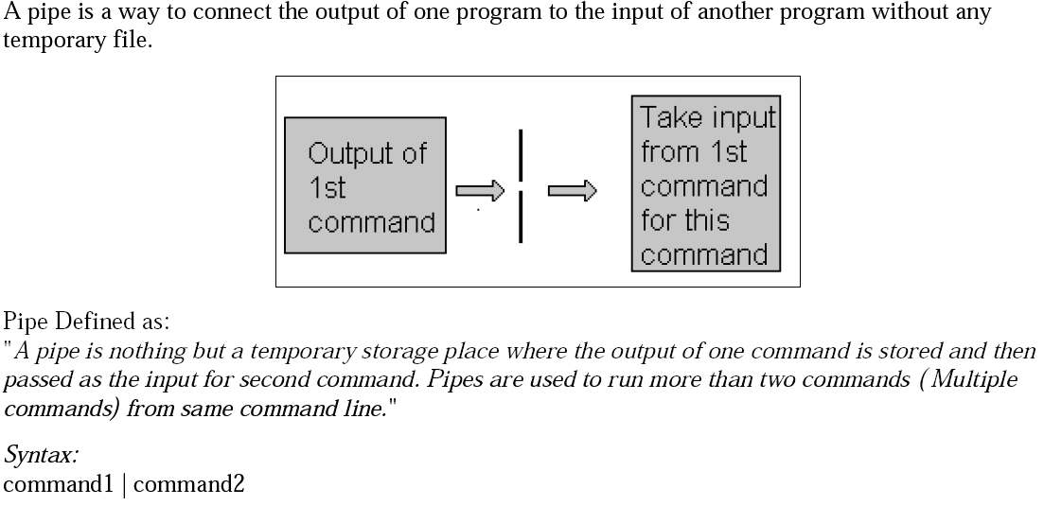
PIPES

Slide 33
A pipe is a form of redirection (transfer of standard output to some other destination) that is used in Linux and other Unix-like operating systems to send the output of one command/program/process to another command/program/process for further processing.
You can make it do so by using the pipe character ‘|’.
It can also be visualized as a temporary connection between two or more commands/ programs/ processes.
Pipes are unidirectional i.e data flows from left to right through the pipeline.
The pipe acts as a container which takes the output of ls -l and gives it to more as input. This command does not use a disk to connect standard output of ls -l to the standard input of more because pipe is implemented in the main memory.

Slide 34
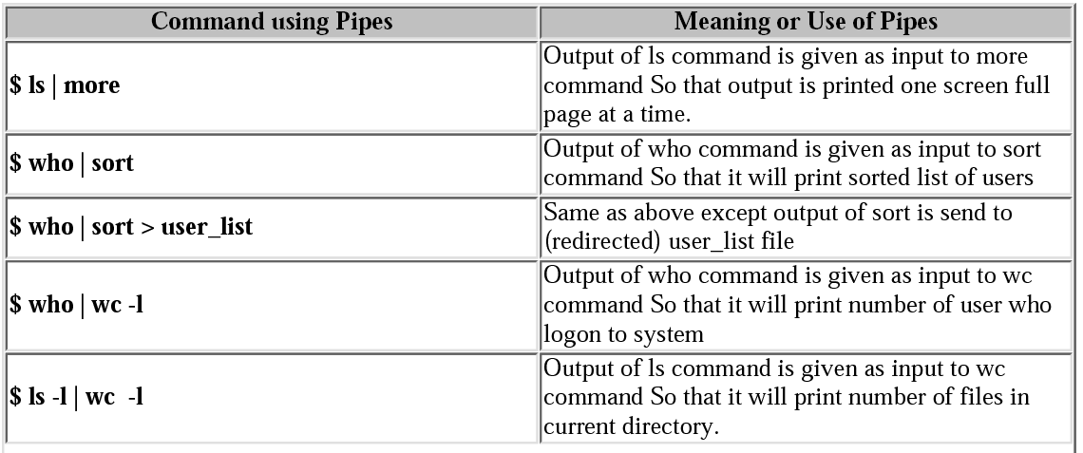
PIPE(Examples)

Slide 35
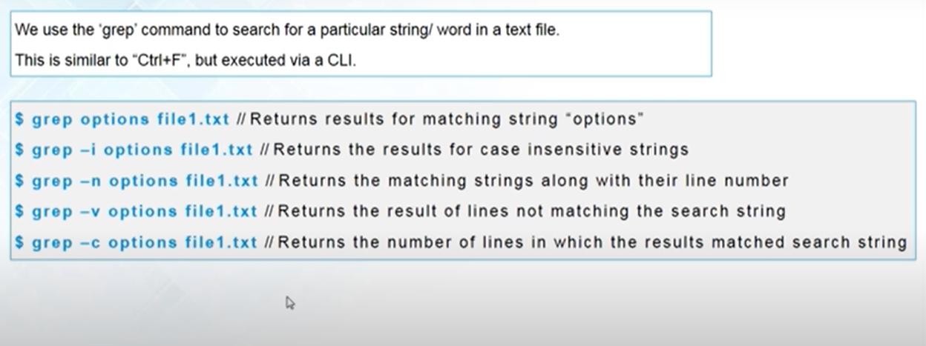
Grep Command
grep searches the named input FILEs for lines containing a match to the given PATTERN.

